Slide 1
Water quality and socio-economic simulations of the Yangtze River Basin
Group: STE
Group Members:
Zhi Li (4765729)
Xinxin Sui (4691326)
Chang Gao (4725735)

Slide 2
Contents
Brief Introduction
Save The Environment (STE):
Completely Mixed System
a) Model Configuration and Results
b) System Diagnosis
Incompletely Mixed System
a) Model Configuration and Results
Save The Economy (STE)

Slide 3
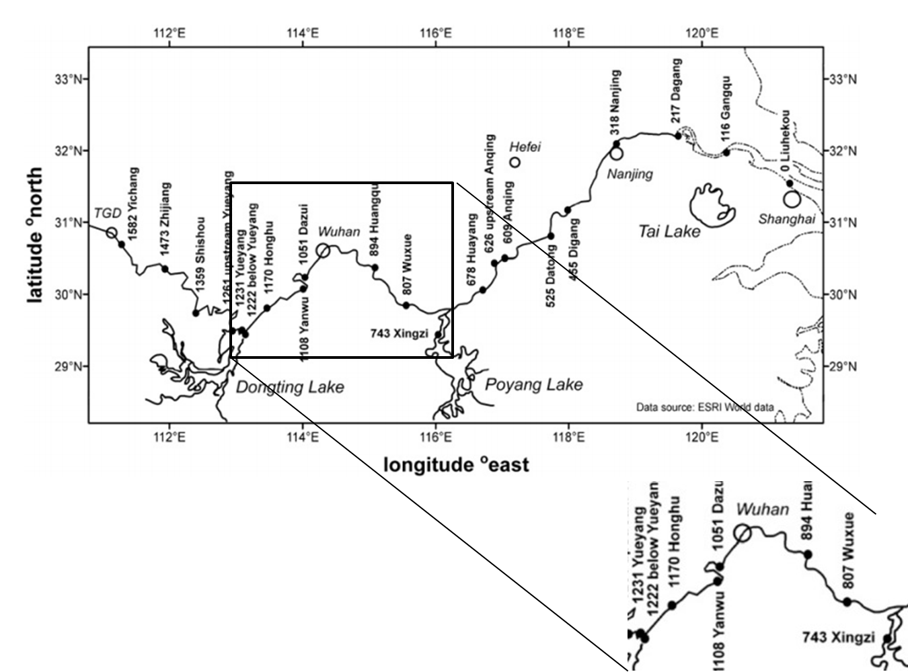
Brief Introduction Areas Under Simulation

Slide 4
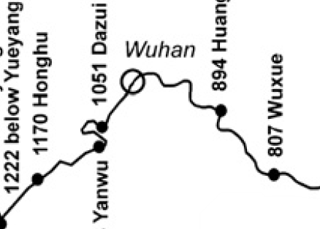
Brief Introduction Areas Under Simulation
 | Reactor 1 | Reactor 2 | Reactor 3 | Reactor 4 | Reactor 5
Length(km) | 52 | 62 | 57 | 157 | 87
W of COD (kg/s) | 4.632 | 4.849 | 4.537 | 5.362 | 5.221
W of Nitrogen(kg/s) | 0.786 | 0.863 | 0.842 | 1.112 | 0.965
3
4
5
2
1

Slide 5
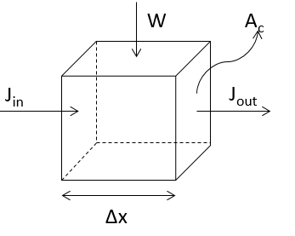
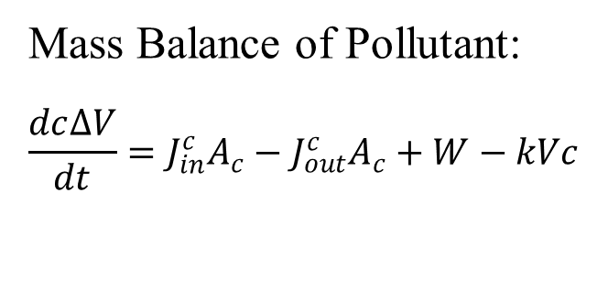
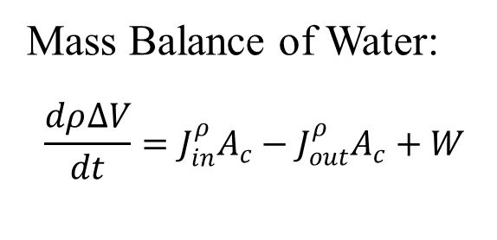
Environmental Perspective Model Description
Mass Balance of Water:
$$\frac{dρ∆V}{dt}=J_{in}^{ρ}A_{c}−J_{out}^{ρ}A_{c}+W$$
Mass Balance of Pollutant:
$$\frac{dc∆V}{dt}=J_{in}^{c}A_{c}−J_{out}^{c}A_{c}+W−kVc$$
At steady state !
Notes:
补充点 静态数据

Slide 6
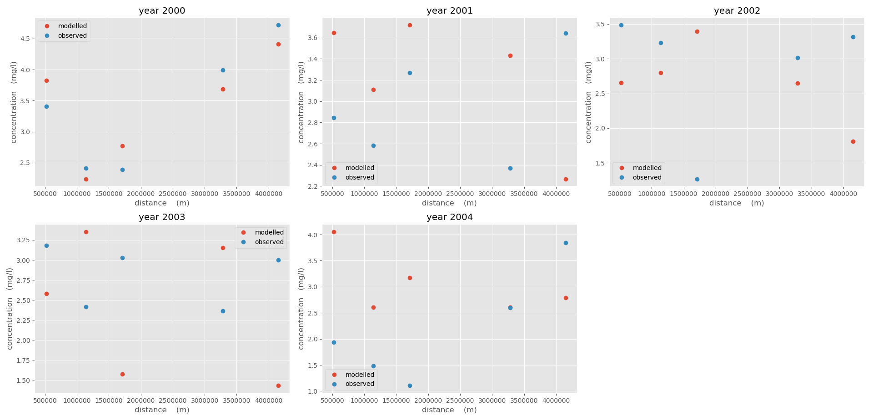
Completely Mixed System (2000 - 2004) Model Results of COD
k = 0.0291 /d

Slide 7
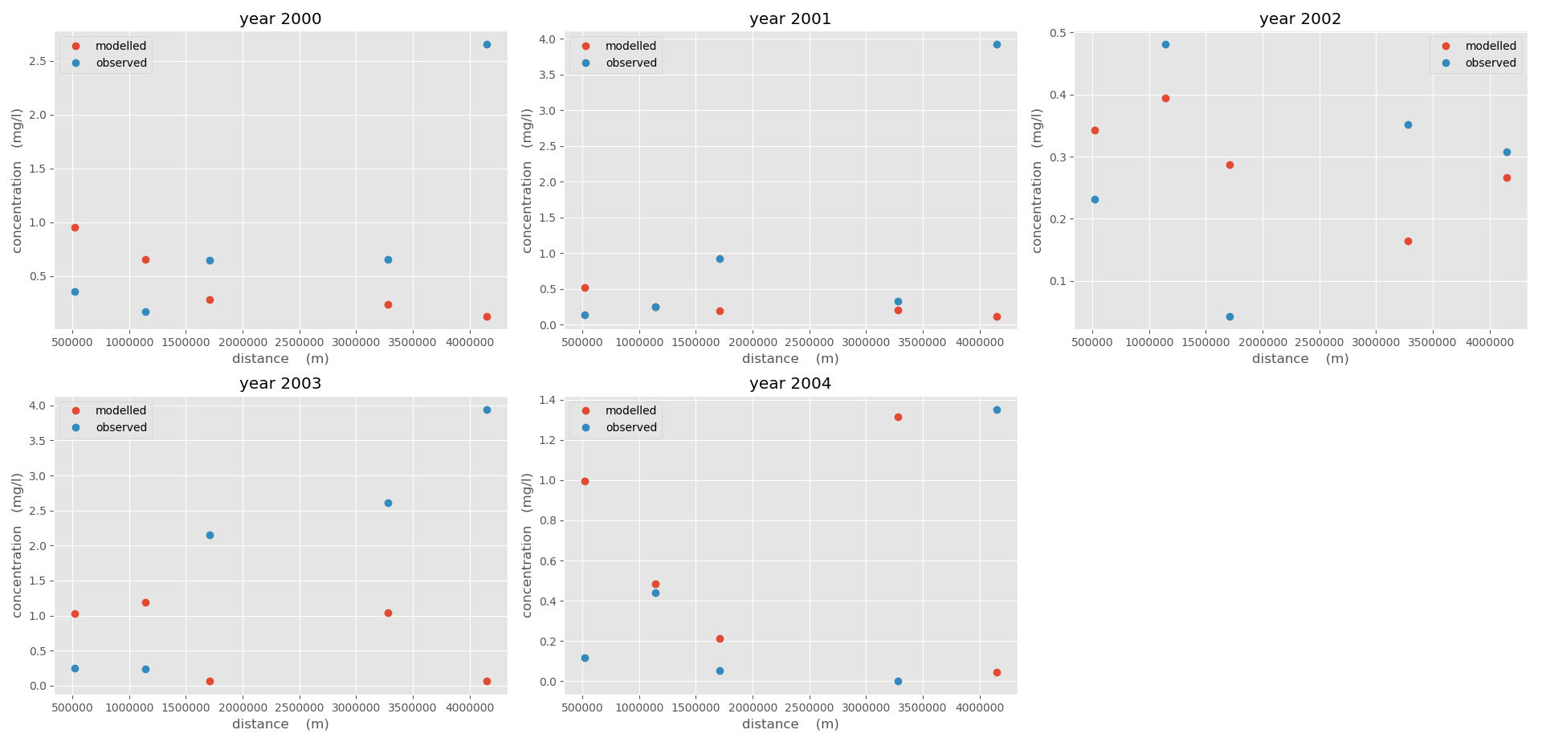
Completely Mixed System (2000 - 2004) Results of Nitrogen
k = 0.283 /d

Slide 8
Completely Mixed System (2000 - 2004) Results Analysis
Possible Reasons:
Data scarcity?
First order decay?
Simplified model?
Integrated decay factor?

Slide 9


Completely Mixed System (2000 - 2004) System Diagnosis
System Susceptibility:
a: assimilation factor
System Recovery Time:

Slide 10
System Susceptibility Analysis
System Diagnosis
Table. Assimilation factor of COD
Year | Reactor 1 | Reactor 2 | Reactor 3 | Reactor 4 | Reactor 5
2000 | 34.3147 | 34.311 | 34.313 | 34.3136 | 34.3133
2001 | 34.3148 | 34.3112 | 34.3132 | 34.3136 | 34.3132
2002 | 34.3147 | 34.311 | 34.313 | 34.3137 | 34.3134
2003 | 34.3148 | 34.311 | 34.3131 | 34.3135 | 34.3132
2004 | 34.3148 | 34.311 | 34.313 | 34.3136 | 34.3135
Mean | 34.31476 | 34.31104 | 34.31306 | 34.3136 | 34.31332
std | 5.48E-05 | 8.94E-05 | 8.94E-05 | 7.07E-05 | 0.00013

Slide 11
System Susceptibility Analysis
System Diagnosis
Table. Assimilation factor of Nitrogen
Year | Reactor 1 | Reactor 2 | Reactor 3 | Reactor 4 | Reactor 5
2000 | 197404 | 122002 | 152898 | 165097 | 160037
2001 | 201335 | 124532 | 156260 | 166811 | 157076
2002 | 197818 | 121798 | 153359 | 167412 | 160801
2003 | 199871 | 121517 | 155021 | 163996 | 157164
2004 | 199715 | 121315 | 153052 | 165335 | 162902
Mean | 199228.6 | 122232.8 | 154118 | 165730.2 | 159596
std | 1442.576944 | 1173.317 | 1311.824 | 1229.728 | 2228.953

Slide 12
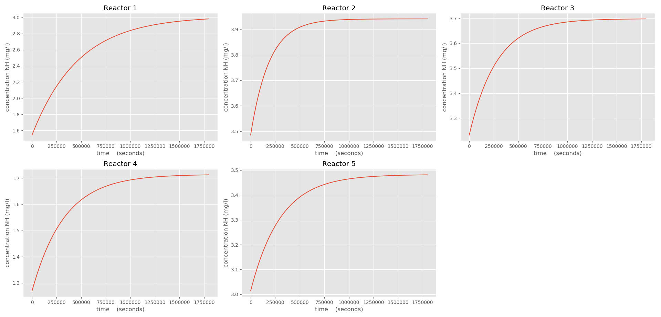
System Recovery Time of COD (2002) System Diagnosis

Slide 13
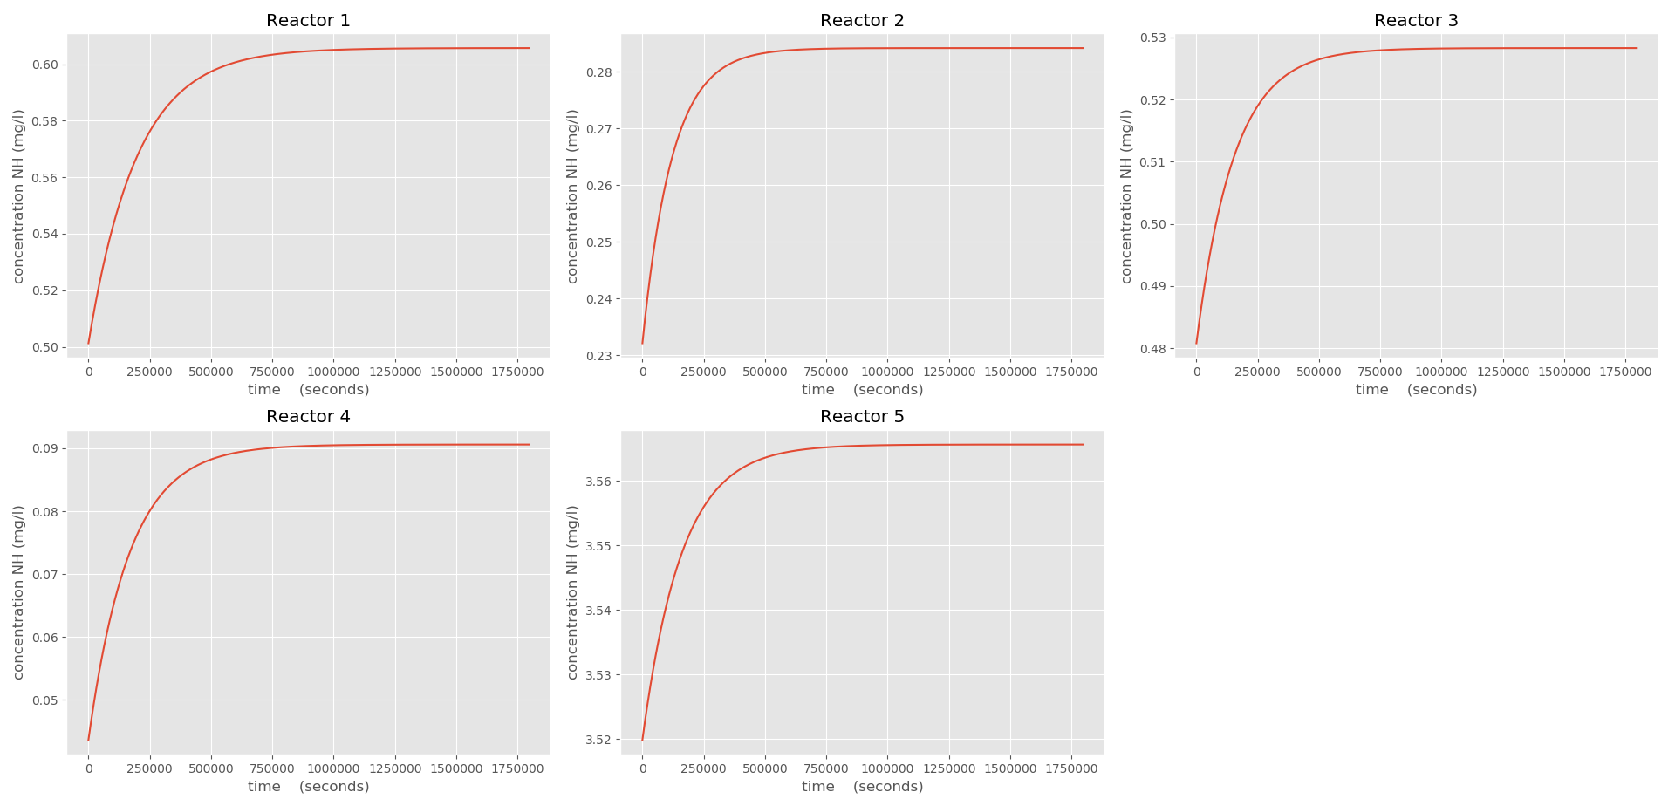
System Recovery Time of Nitrogen (2002) System Diagnosis
Notes:
Seconds→hours

Slide 14
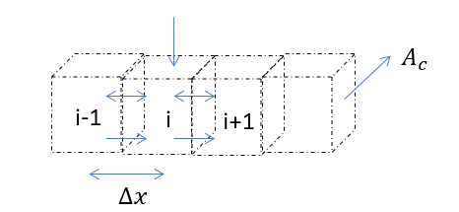
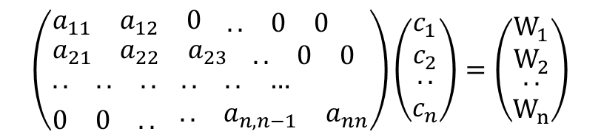
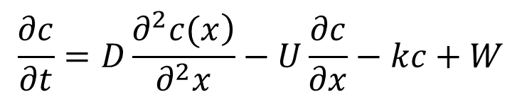
Incompletely Mixed System Prediction
一 Control Volume Approach
Matrix form:
$$\left(\begin{aligned}&\begin{matrix}a_{11} & a_{12} & 0\end{matrix} \begin{matrix}.. & 0 & 0\end{matrix} \\ &\begin{matrix}a_{21} & a_{22} & a_{23}\end{matrix} \begin{matrix}.. & 0 & 0\end{matrix} \\ &\begin{matrix}.. & .. & ..\end{matrix} \begin{matrix}.. & .. & …\end{matrix} \\ &\begin{matrix}0 & 0 & ..\end{matrix} \begin{matrix}.. & a_{n,n−1} & a_{nn}\end{matrix}\end{aligned}\right)\left(\begin{matrix}\begin{aligned}&c_{1} \\ &c_{2}\end{aligned} \\ .. \\ c_{n}\end{matrix}\right)=\left(\begin{matrix}\begin{aligned}&W_{1} \\ &W_{2}\end{aligned} \\ .. \\ W_{n}\end{matrix}\right)$$
$$\frac{∂c}{∂t}=D\frac{\left.∂^{2}c(x\right)}{∂^{2}x}−U\frac{∂c}{∂x}−kc+W$$

Slide 15
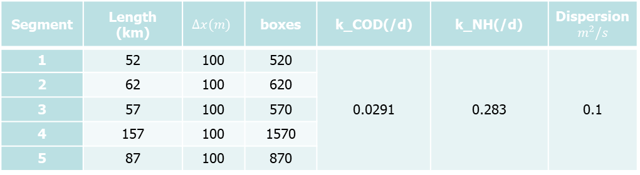
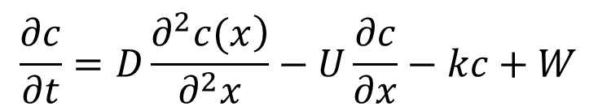
Incompletely Mixed System Prediction
一 Control Volume Approach
$$\frac{∂c}{∂t}=D\frac{\left.∂^{2}c(x\right)}{∂^{2}x}−U\frac{∂c}{∂x}−kc+W$$
Model Configuration:
Segment | Length (km) | $$∆x(m)$$ | boxes | k_COD(/d) | k_NH(/d) | Dispersion $$m^{2}/s$$
1 | 52 | 100 | 520 | 0.0291 | 0.283 | 0.1
2 | 62 | 100 | 620
3 | 57 | 100 | 570
4 | 157 | 100 | 1570
5 | 87 | 100 | 870

Slide 16
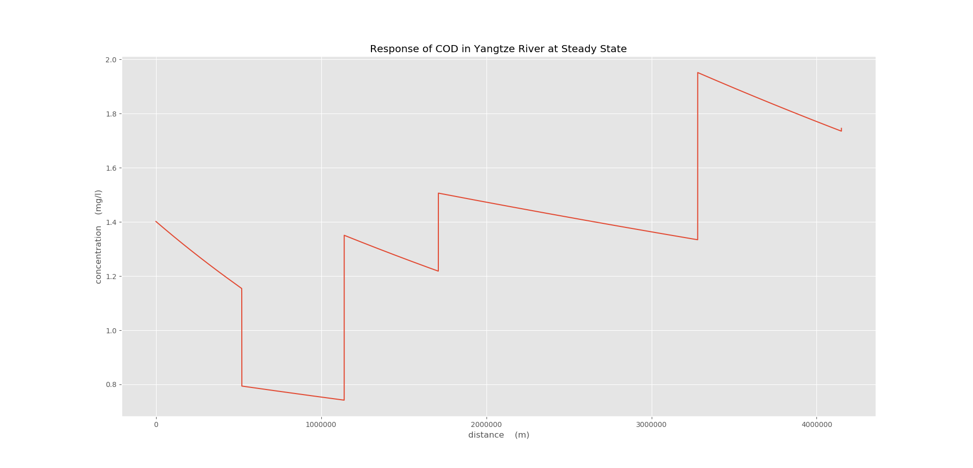
Incompletely Mixed System Prediction of COD in 2005

Slide 17
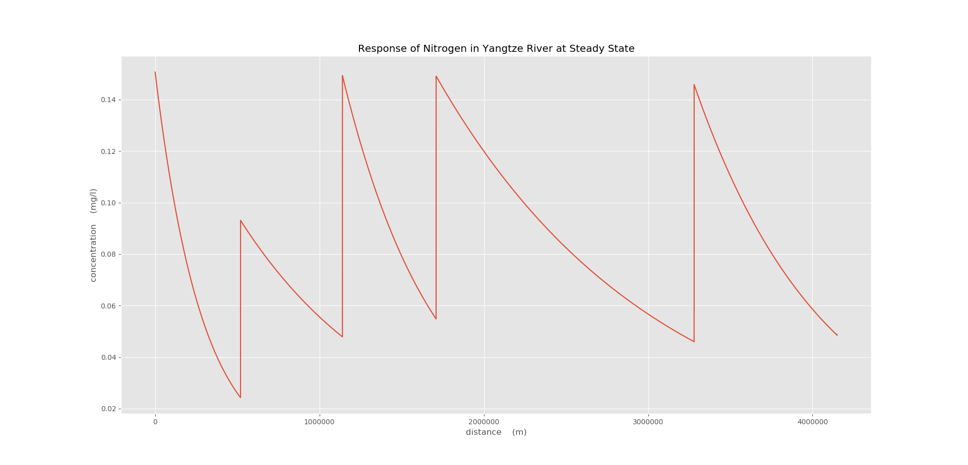
Incompletely Mixed System Prediction of Nitrogen in 2005

Slide 18
Contents
Brief Introduction
Save The Environment (STE):
Save The Economy (STE)
Social-Economic modelling
a) Model Description
b) Model Configuration and Results
Environmental Prediction
Social-Environmental Issue Over Generations
a) Model Configuration and Results

Slide 19


Social-Economy modelling Model Description
$$X=A1×{Lx}^{α}×{Cx}^{(1−α)}$$
$$Y=A2×{Ly}^{α}×{Cy}^{(1−α)}$$
Two Products:
X - Cotton Production (tons)
Y - Industry Output Value (billions)
Two Resources:
L - Land use (km²)
C – Capital (billions)

Slide 20
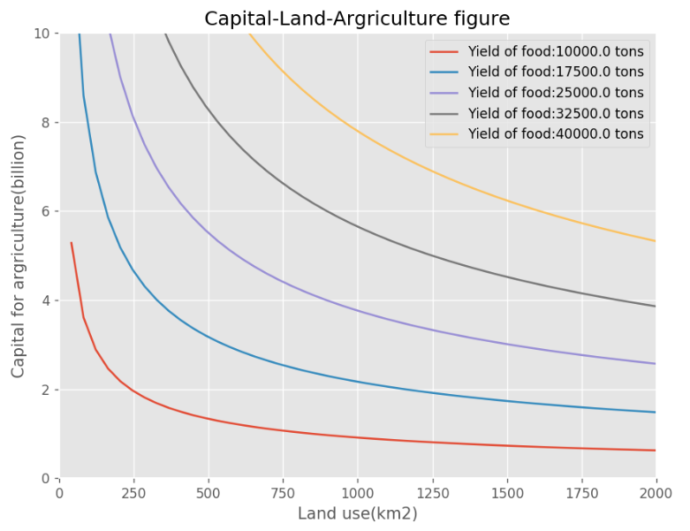
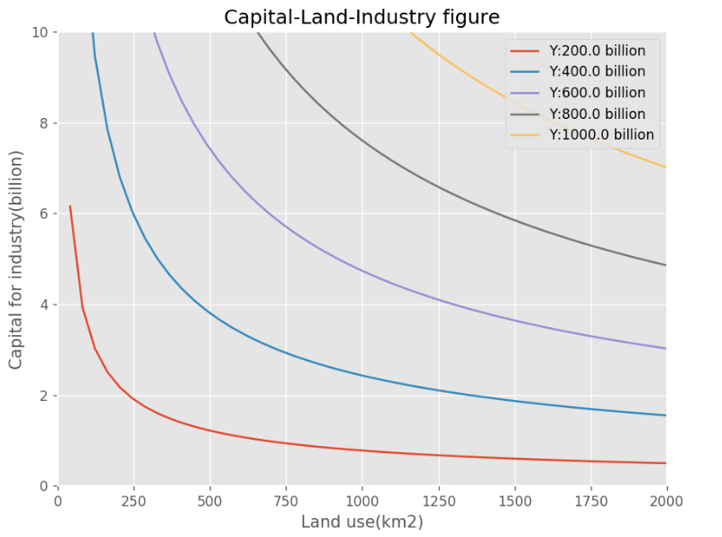

Social-Economy modelling Model Configuration of 2000
$$X=915.85×{Lx}^{0.355}×{Cx}^{0.645}$$
$$Y=15.45×{Ly}^{0.393}×{Cy}^{0.607}$$

Slide 21
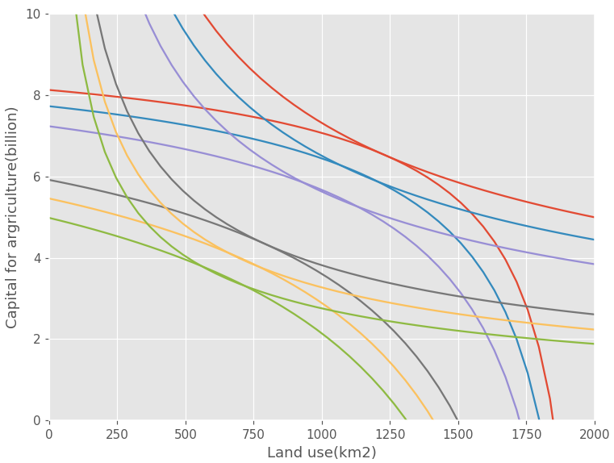
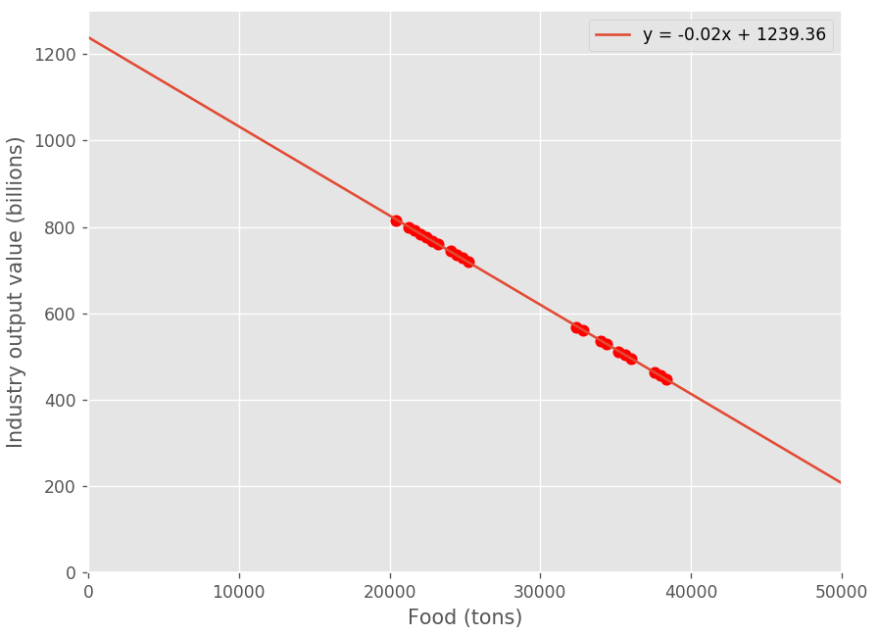
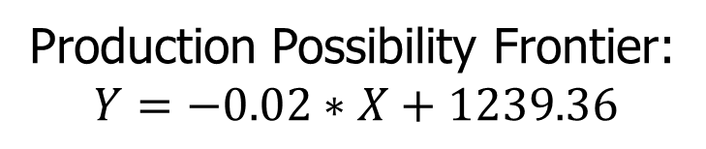
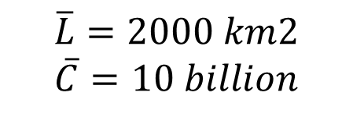
Social-Economy modelling Model Configuration of 2000
$$\overline{L}=2000 km2$$
$$\overline{C}=10 billion$$
Production Possibility Frontier:
$$Y=−0.02∗X+1239.36$$

Slide 22
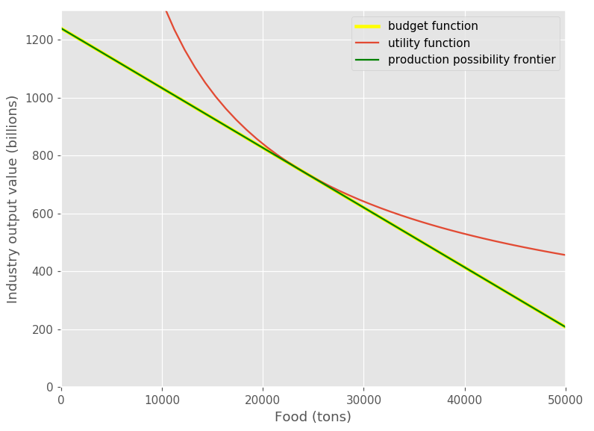

Social-Economy modelling Model Configuration of 2000
U = ln(C1)+ $η\ln\left(C2\right)$
$$M=P1∗C1+P2∗C2$$
$$Y=−0.02∗X+1239.36$$
$$η=1.5$$
C1-consumption of cotton
C2-consumption of industry
P1-Price of cotton
P2-Price of industry
Through the Largrange deriviation:
U(2000) = 20.004

Slide 23
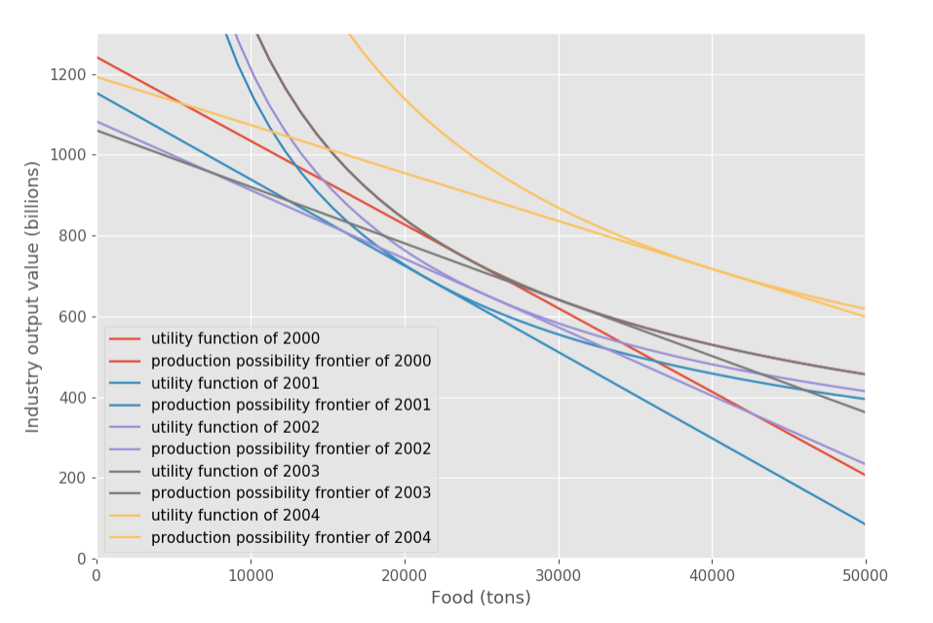
Social-Economy modelling Model Result from 2000 to 2004
Year | Utility Value
2000 | 20.004
2001 | 20.09
2002 | 20.16
2003 | 20.32
2004 | 20.458

Slide 24
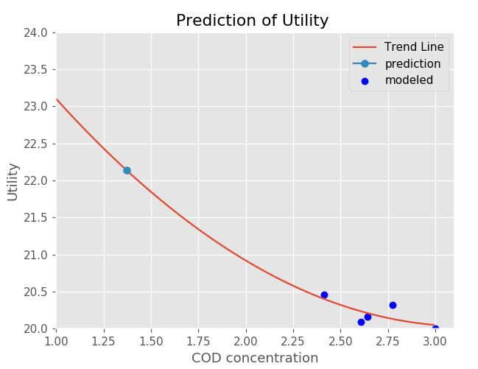
Environmental Prediction Connection between COD and utility value
Year | Utility Value | COD (mg/L)
2000 | 20.004 | 3.0013
2001 | 20.09 | 2.6073
2002 | 20.16 | 2.6434
2003 | 20.32 | 2.7744
2004 | 20.458 | 2.4149
COD decreases by 19.54%; Utility Value increases by 2.27% from 2000 to 2004.
According to the COD prediction value, the utility value will increase by 7.80%.

Slide 25
Contents
Brief Introduction
Save The Environment (STE):
Save The Economy (STE)
Social-Economic modelling
a) Model Description
b) Model Configuration and Results
Environmental Prediction
Social-Environmental Issue Over Generations
a) Model Configuration and Results

Slide 26

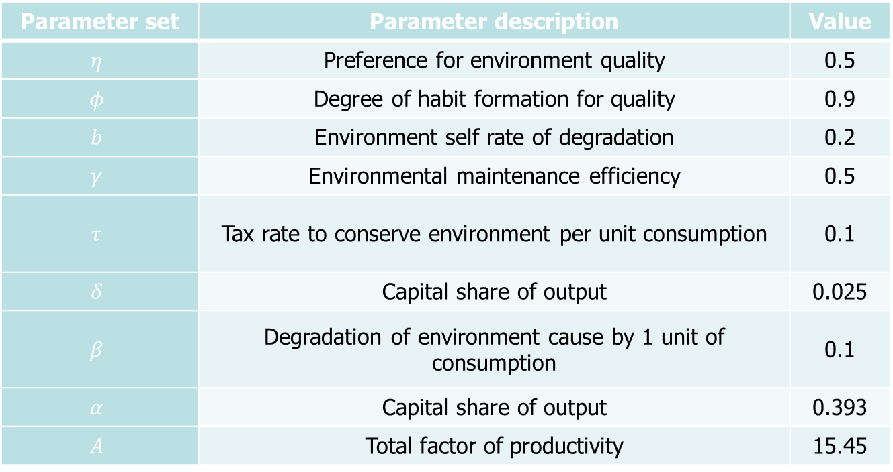
Social-environmental issue over generations
Parameter set | Parameter description | Value
$$η$$ | Preference for environment quality | 0.5
$$φ$$ | Degree of habit formation for quality | 0.9
$$b$$ | Environment self rate of degradation | 0.2
$$γ$$ | Environmental maintenance efficiency | 0.5
$$τ$$ | Tax rate to conserve environment per unit consumption | 0.1
$$δ$$ | Capital share of output | 0.025
$$β$$ | Degradation of environment cause by 1 unit of consumption | 0.1
$$α$$ | Capital share of output | 0.393
$$A$$ | Total factor of productivity | 15.45
$$Y=A×{Ly}^{α}×{Cy}^{(1−α)}$$

Slide 27
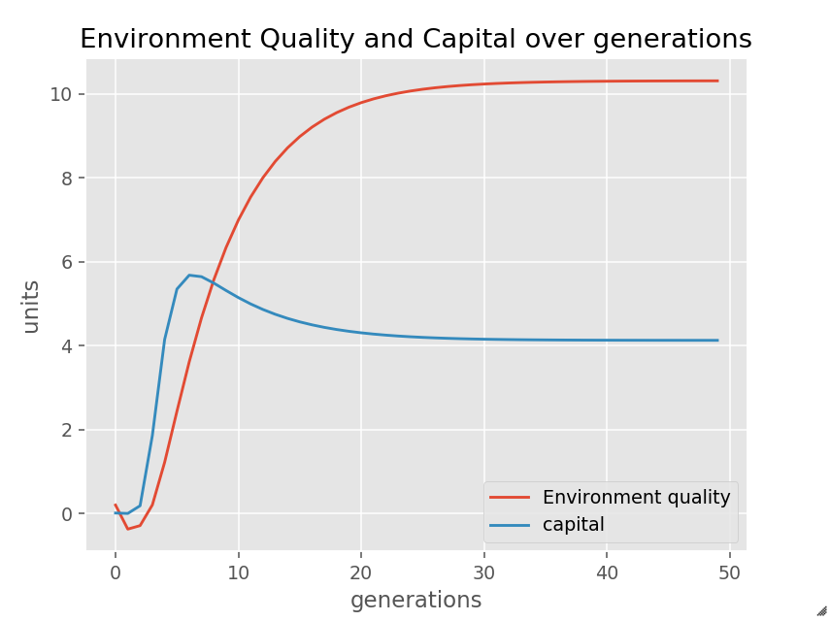
Social-environmental issue over generations

Slide 28
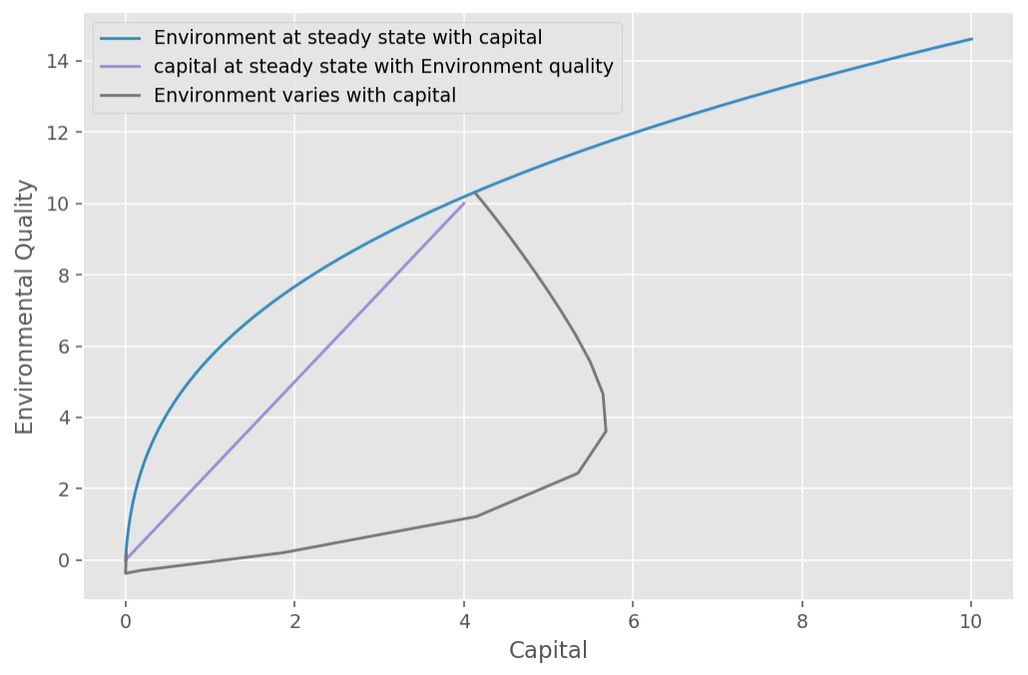
Social-environmental issue over generations Environment and Capital evolve until Equilibrium Point

Slide 29
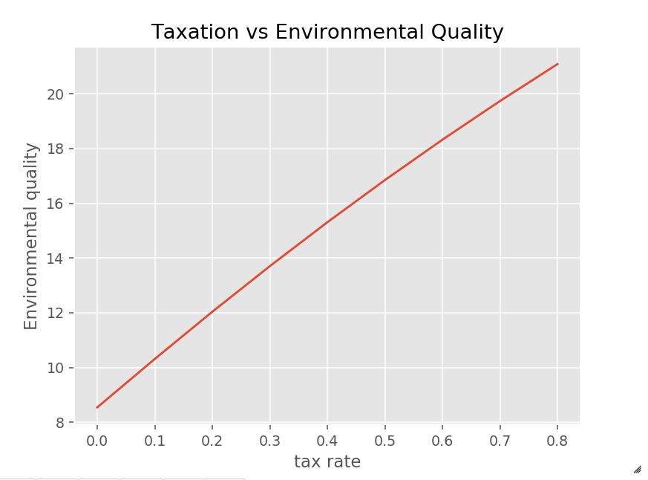
Social-environmental issue over generations How taxation affect the environment

Slide 30
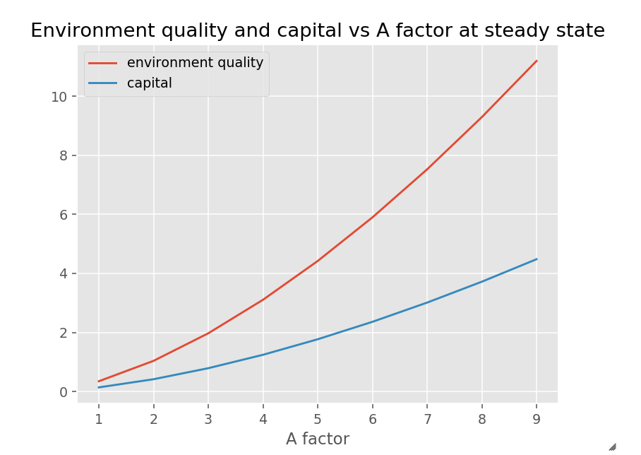

Social-environmental issue over generations How technology affects the environment
$$Y=A×{Ly}^{α}×{Cy}^{(1−α)}$$

Slide 31
Conclusions
Our environmental models are oversimplified to represent the real situation.
Social development and Environment quality are closely associated and complicated under different combinations of parameter sets.
The parameterization of the dynamic model can direct us to a certain level understanding the evolutions of environment and society

